Slide 1

Safety & Operational Excellence
Safety Compliance & Daily Practices
John D. Love
January 2026
Notes:
Note: Before beginning, check your systems settings (Microsoft Teams, Google Meet, Zoom, etc.); confirm your audio and video is on and working.
Keep your camera on and welcome participants and introduce yourself but wait until all participants are on the call before starting. Explain what participants can expect from the training. Ask participants to turn on their cameras to “meet” each other as you introduce the training. Beyond the course introduction, depending on your style and how you’d like to display the presentation, feel free to leave your camera on or turn your camera off.
Explain that this session focuses on keeping people safe while maintaining operational reliability. Emphasize that the guidance applies to both frontline technicians and supervisors.

Slide 2

Learning Objectives
By the end of this session, you will be able to:
Identify key safety responsibilities at JDL Data Centers
Recognize common operational hazards
Apply daily safety practices aligned with compliance requirements
Respond appropriately to safety incidents
Notes:
Set expectations.
Ask participants if they have any questions before you proceed?
Reinforce that this is not just policy review — it’s about how safety shows up in daily work.

Slide 3
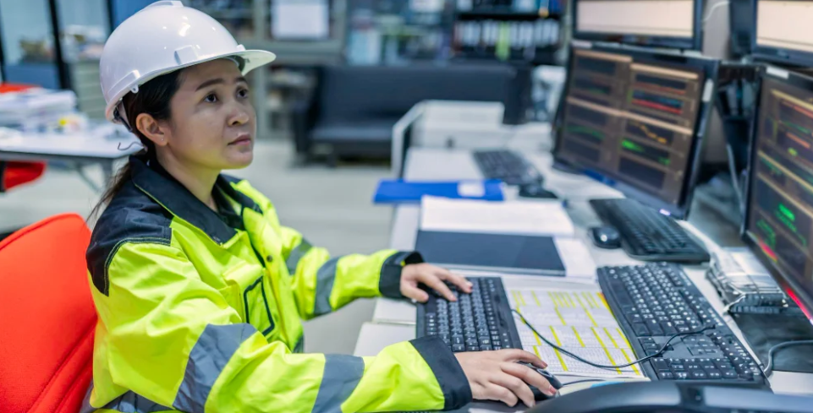
Why Safety Matters in Data Centers
Protect people and critical infrastructure
Prevent downtime and equipment damage
Meet regulatory and operational standards
Notes:
Discuss how safety incidents impact:
Employees and contractors
Facility uptime
Customer trust
Use a brief real-world example (e.g., electrical or equipment handling incident).
Encourage discussion on why safety matters in data centers, specifically.

Slide 4

JDL Data Centers’ Safety Culture
Safety is everyone’s responsibility
Risks are identified early and addressed proactively
Compliance and operations work together
Notes:
Explain that safety is not “extra work” — it is built into how JDL Data Centers operates.
Supervisors model expectations; operators apply them daily.

Slide 5
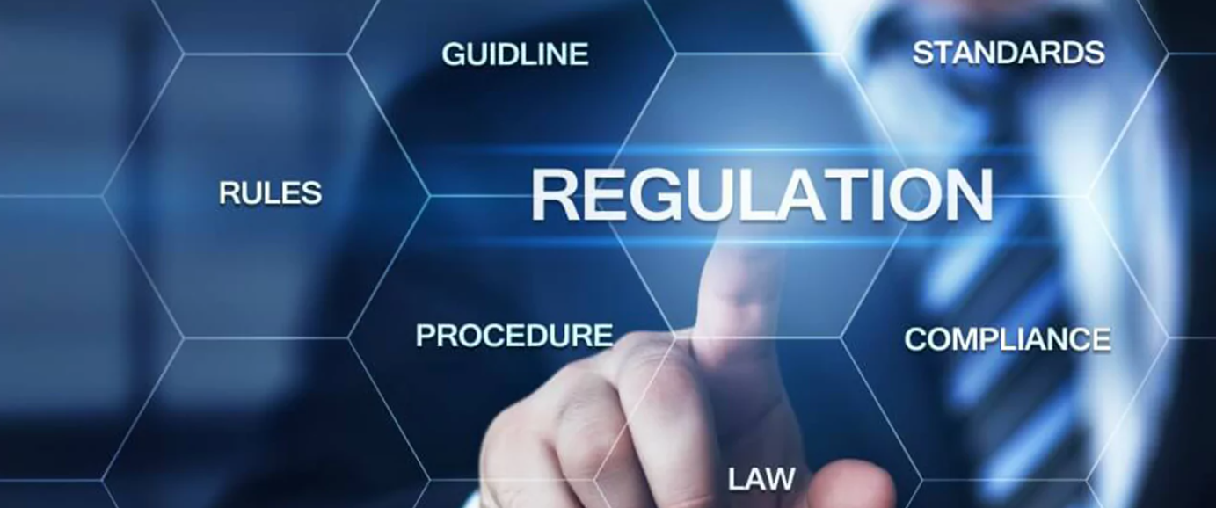
Standards & Regulations Overview
OSHA workplace safety requirements:
ISO 45001 – Occupational Health & Safety
SOC 1 / SOC 2 – Operational controls
Uptime Institute M&O principles
Notes:
This slide is awareness-level.
Stress that employees are not expected to memorize standards — but they must follow site procedures that support them.

Slide 6


Roles & Responsibilities
Frontline Technicians
Follow safety procedures
Use PPE and LOTO correctly
Report hazards and incidents
Supervisors
Ensure compliance
Address hazards promptly
Coach and reinforce safe behaviors
Notes:
Emphasize shared accountability.
Ask: “What happens if either role skips their responsibility?”
Encourage discussion by asking follow-up questions.

Slide 7
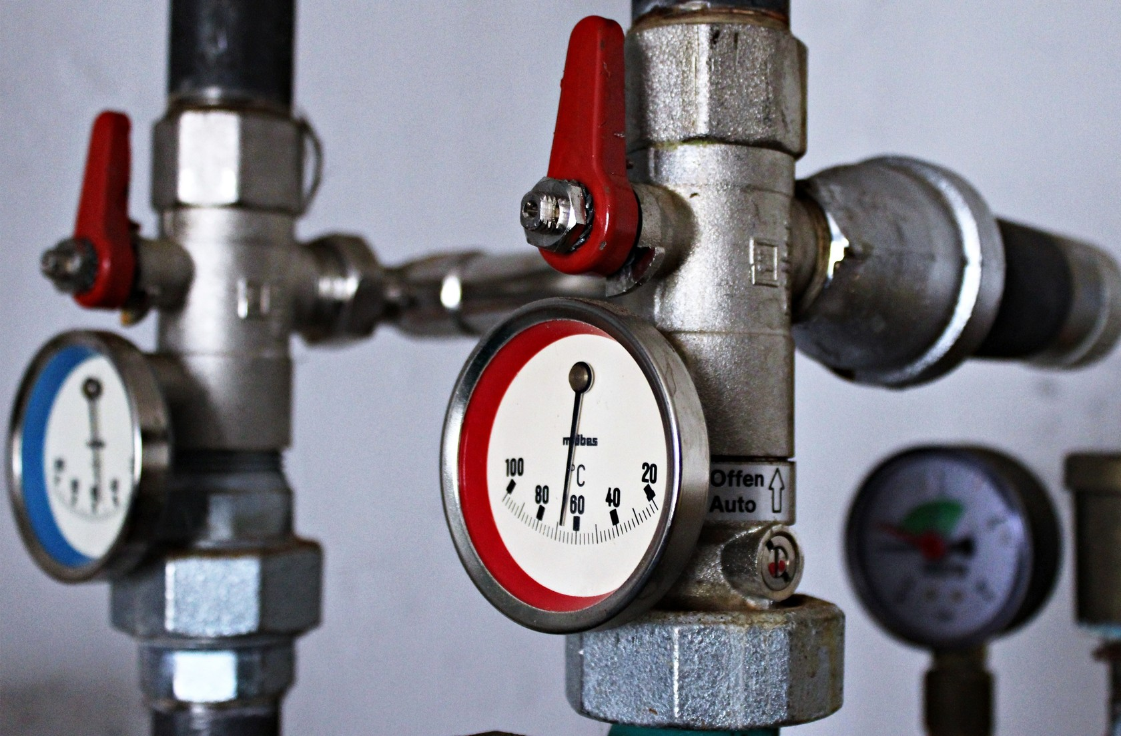
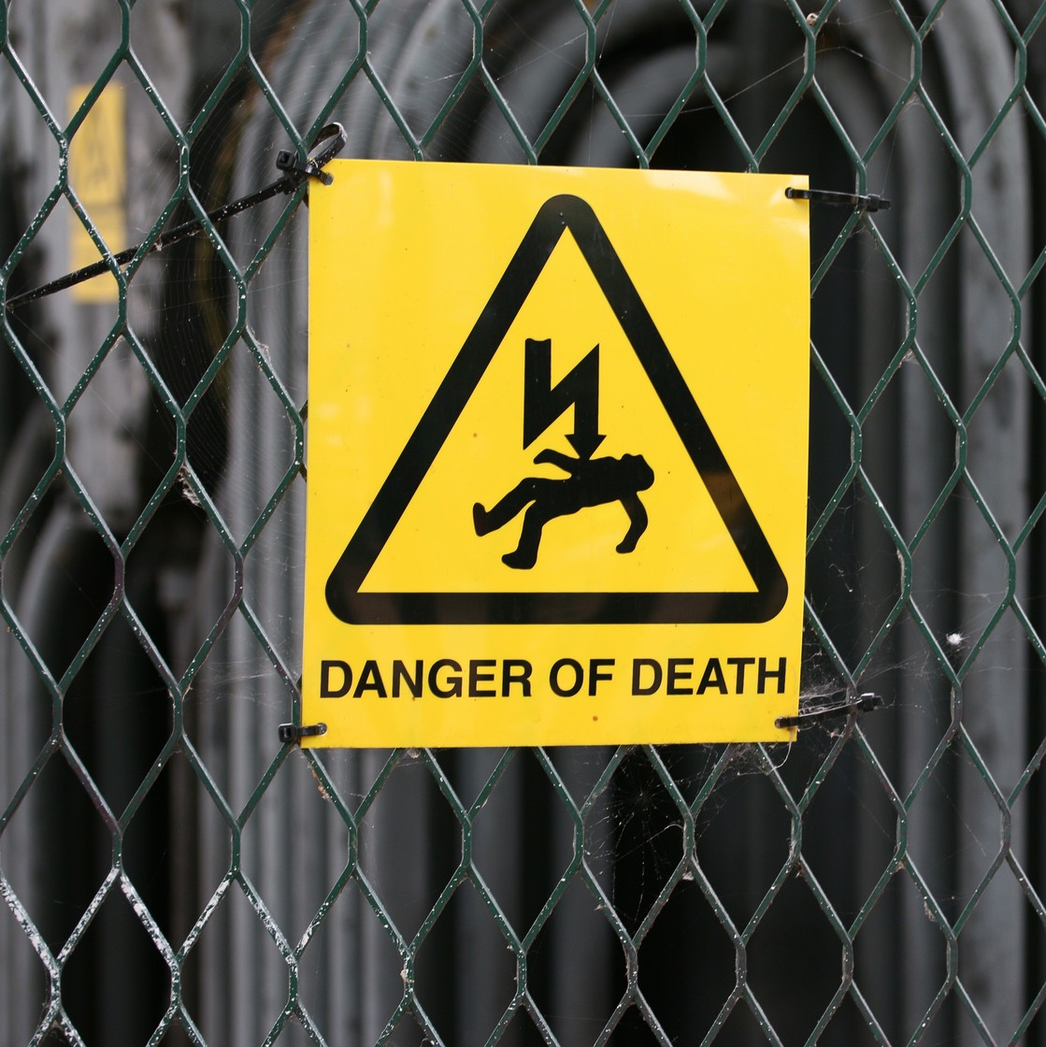
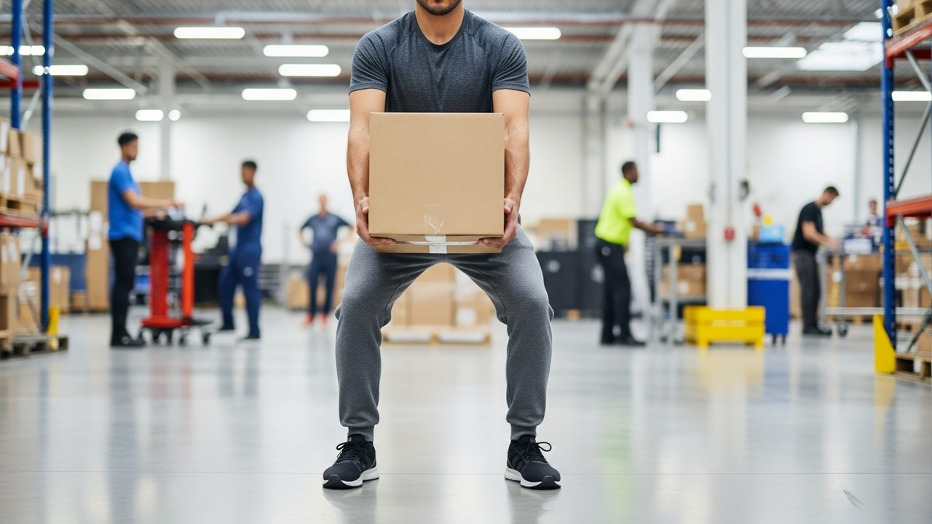
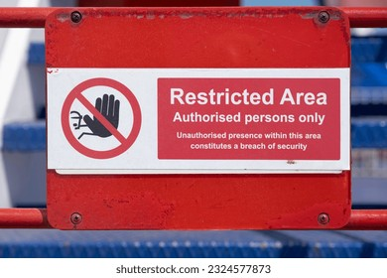
Common Operational Hazards
Electrical systems
Moving or heavy equipment
Environmental risks (heat, noise)
Restricted or high-risk areas
Notes:
Briefly introduce each category. Explain that recognizing hazards early is the first step in prevention.
Ask, “Who has some examples – from your own experience – in handling these kinds of operational hazards? Does anyone have any stories to share about any of these hazards?”
Encourage discussion by asking follow-up questions.

Slide 8

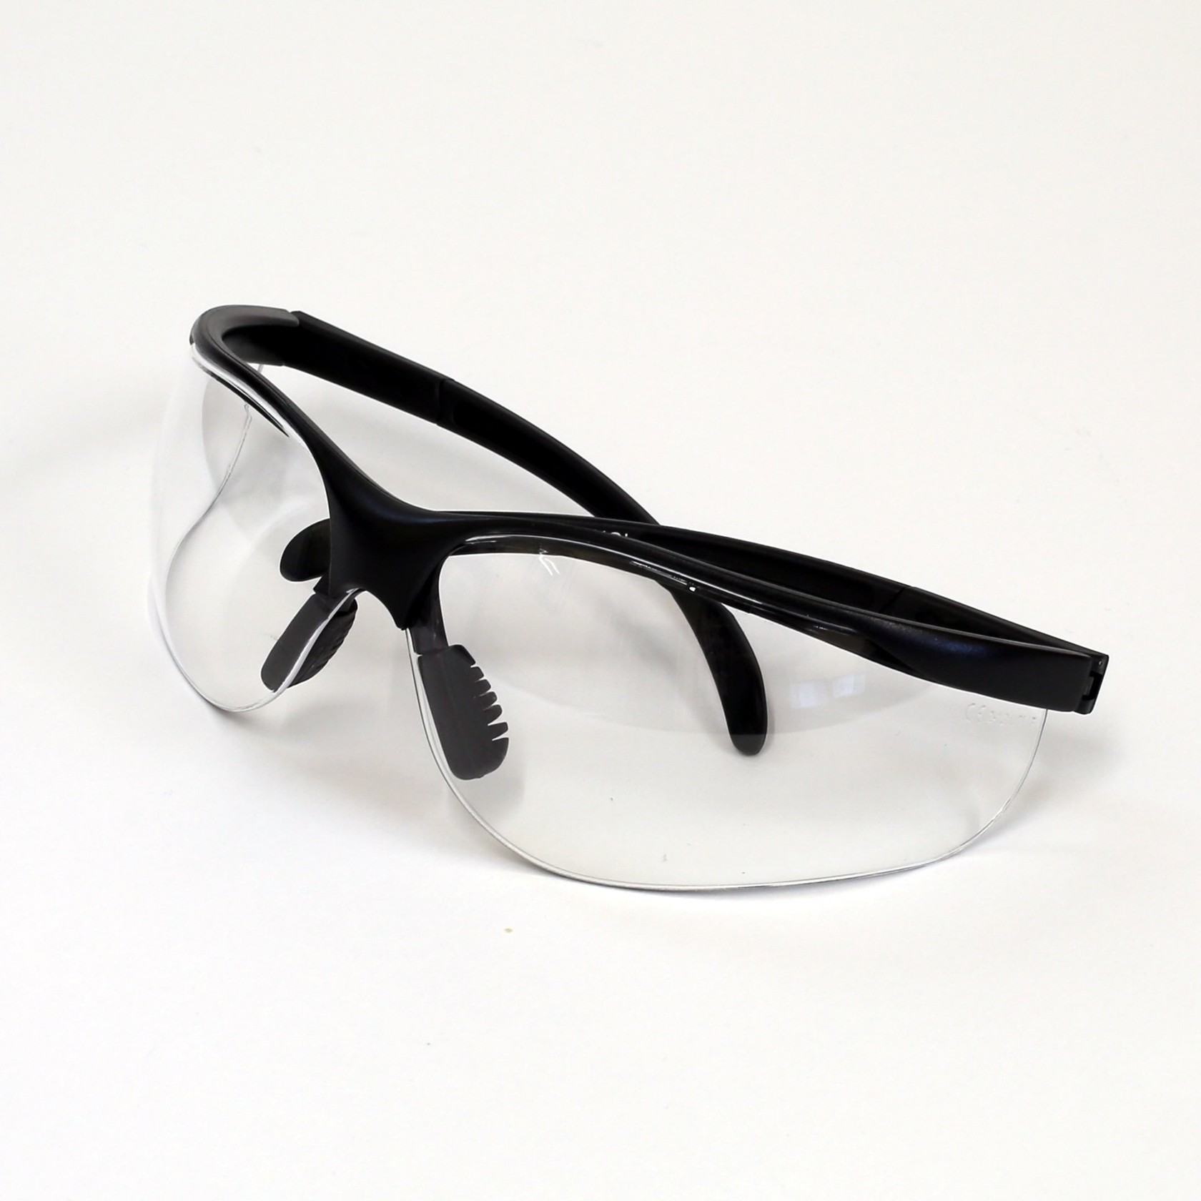
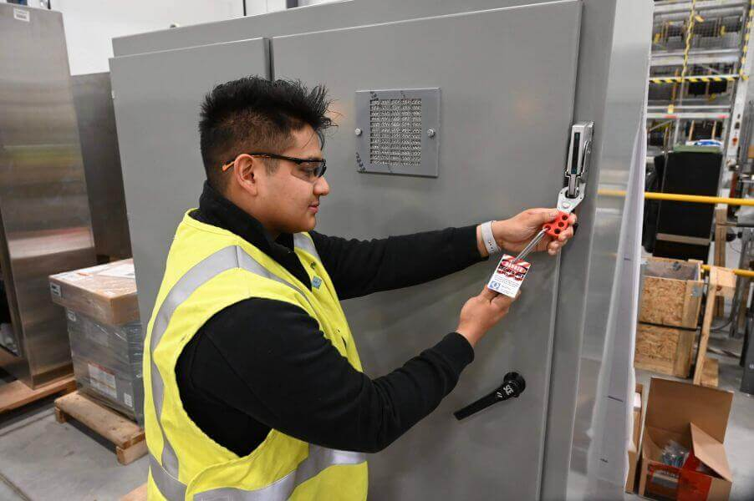
Electrical Safety
Lockout/Tagout (LOTO)
Proper PPE required
Authorized access only
Notes:
Stress zero tolerance for bypassing LOTO.
Ask participants to share a common electrical risk situations they’ve experienced.
Encourage discussion.

Slide 9
Equipment Handling & Movement
Use proper lifting techniques
Use approved lifting aids
Keep aisles and pathways clear
Notes:
Explain how small shortcuts often lead to injuries.
Tie equipment handling to both personal safety and asset protection.
Encourage discussion.

Slide 10
High-Risk & Restricted Areas
Server rooms
Generator rooms
Electrical vaults
Notes:
Explain access controls and why they matter.
Reinforce that restricted areas exist to prevent incidents, not slow work.
Encourage discussion.

Slide 11
Daily Safety Practices
Wear required PPE
Follow site-specific procedures
Maintain situational awareness
Notes:
This is the “every shift” slide.
Ask: “What’s one daily habit that helps prevent incidents?”
Encourage discussion by asking follow-up questions.

Slide 12

Routine Inspections
Emergency exits
Fire protection systems
Environmental monitoring
Housekeeping and cable management
Notes:
Explain who performs inspections and how issues are documented.
Supervisors should reinforce follow-through.
Encourage discussion.

Slide 13

Hazard Identification & Reporting
Identify unsafe conditions
Stop work if necessary
Report hazards immediately
Notes:
Stress that reporting hazards is encouraged, not punished.
Near-misses are learning opportunities.
Encourage discussion.

Slide 14
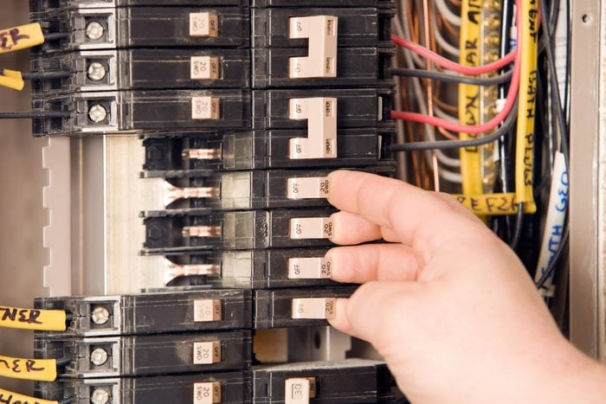
Incident Response: Immediate Actions
Stop work
Secure the area
Ensure personal safety
Notes:
Walk through a simple example: a tripped breaker or equipment malfunction.
Emphasize calm, deliberate action.
Encourage discussion.

Slide 15

Incident Reporting Process
Notify supervisor
Document the incident
Participate in follow-up if needed
Notes:
Clarify timelines and expectations.
Supervisors are responsible for escalation and corrective actions.

Slide 16

Compliance & Documentation
Accurate reporting
Complete documentation
Follow-up actions tracked
Notes:
Tie documentation to audits, investigations, and continuous improvement.
Good records protect employees and the organization.

Slide 17

Compliance & Safety Checklist
PPE used appropriately
LOTO applied when required
Exits and safety equipment accessible
Hazards reported
Incidents documented
Notes:
Explain that this checklist mirrors the job aid.
Encourage participants to use it daily.

Slide 18
Scenario Activity
A temperature alert triggers in a critical area.
The alarm clears, but readings remain elevated.
What are the risks?
What actions should be taken?
When should supervision be notified?
Notes:
Facilitate discussion:
What are the risks?
What actions should be taken?
When should supervision be notified?

Slide 19
Scenario Debrief
Correct response includes:
Do not ignore elevated readings
Follow site procedures
Notify supervisor
Document observations
Notes:
Reinforce correct decision-making.
Tie responses back to safety + uptime.

Slide 20
Summary
Safety and compliance support daily operations
Procedures protect people and infrastructure
Everyone plays a role
Notes:
Summarize the hybrid philosophy:
Rules + real-world application = safe, reliable operations.

Slide 21
Key Takeaways
Follow procedures every shift
Speak up about hazards
Safety is a shared responsibility
Finally, what is one action you will apply immediately?
Notes:
Ask participants to reflect on one action they’ll apply immediately.

Slide 22

Questions & Discussion
Questions?
Notes:
Encourage open discussion and feel free to ask participants to turn on their cameras during discussion and the rest of your presentation.
Acknowledge contributions and thank participants.

Slide 23

Resources & Next Steps
JDL Data Centers’ safety policies
Site-specific procedures, including the Incident Response and Incident Reporting Job Aid
Supervisor contacts
Feedback survey
Notes:
Close the session and explain where to find additional resources. Email – or place in the chat – the links to these resources.
Also send the link to our online feedback survey to participants and explain we would really value their feedback, which will let us know how we did and help us to continuously improve our training offerings.
Finally, share your email – if you haven’t already – and let participants know they can feel free to contact you if they have further questions.
Ask again if there are any final questions. Thank all participants again and end the call.

